Slide 1
Software-Defined Data Center
Overview
Md. Shahed Hasib Bhuiyan
CTO, NNS Solution Ltd
VCIX-NV, VCAP (DCD,DCA), CDCS, CCSP, MCSA
NNS
Date: 04-02-2020

Slide 2
IT Challenges with traditional Hardware Defined Data Center (HDDC)
NNS

Slide 3
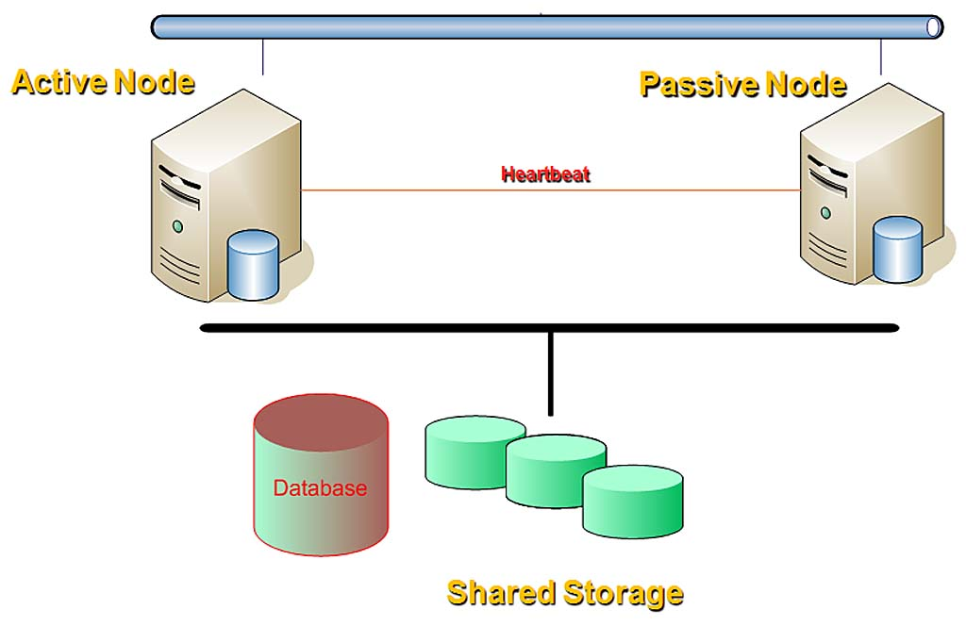
How do we handle server failure in our existing hardware defined data center (HDDC)?
One Application
Active
High CAPEX & OPEX
Two Server
Complex Management
Not all applications are clustered in your Data Center
i.e Not all applications are Highly Available
NNS

Slide 4
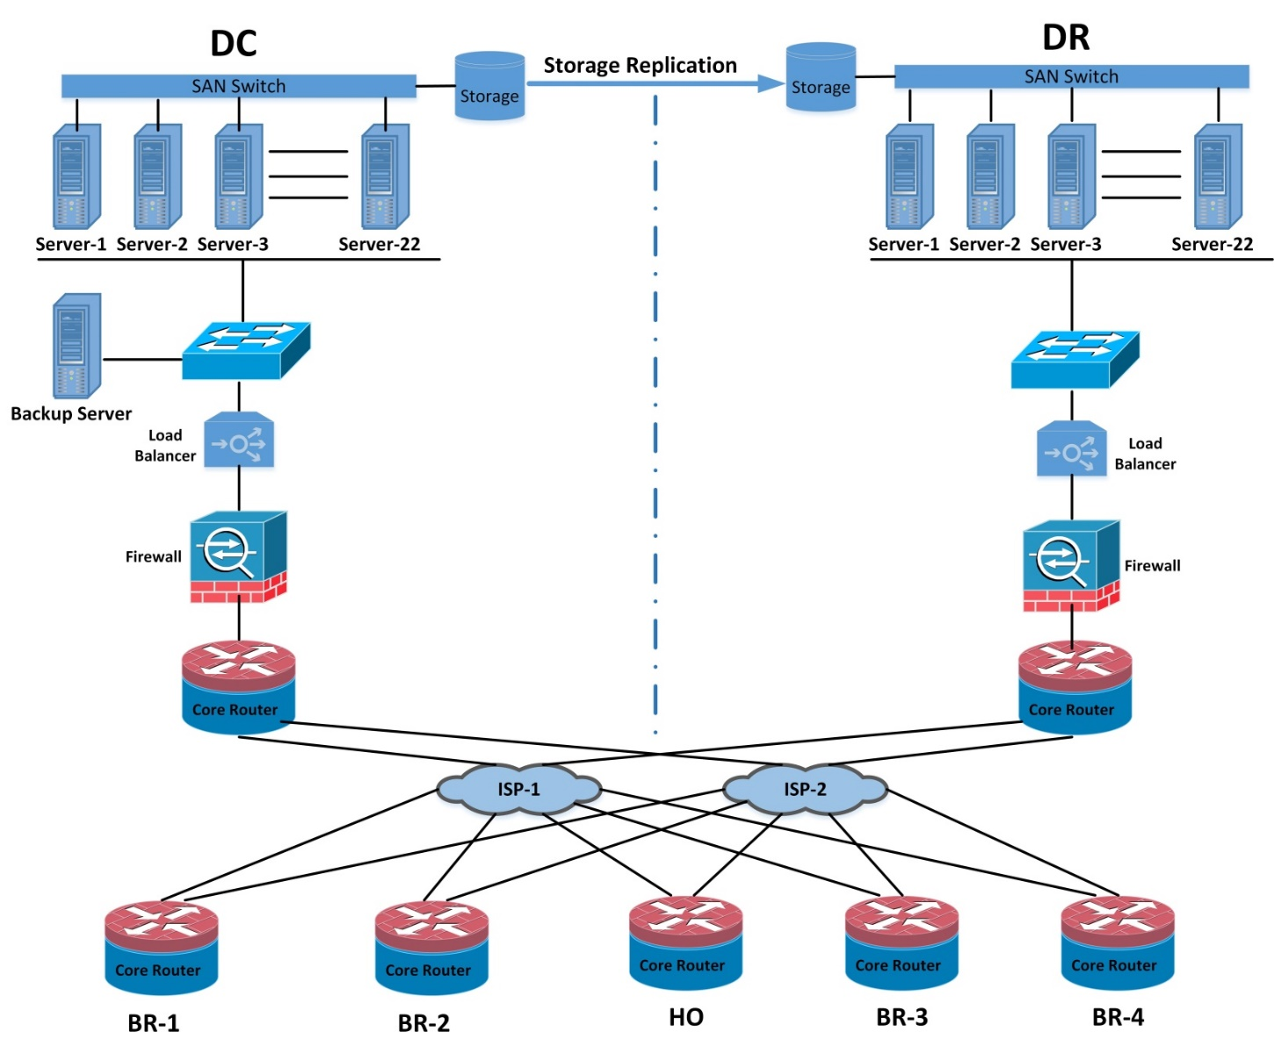
How do we handle Site failure?
Need to maintain same set of Servers and other hardware at both sites
Complexity in maintaining identical configurations at both sites
DR Drill requires huge planning, documentation and time
Increases RTO
We never perform efficient disaster recovery with our traditional hardware defined data center.
NNS

Slide 5
Do you think you were able to handle these IT challenges efficiently with traditional hardware defined data center (HDDC)?
The answer is - NO
What is the right approach for facing these IT challenges?
The answer is
Moving towards the Software-Defined Data Center (SDDC)
NNS

Slide 6
SDDC – The New IT
NNS

Slide 7









What is a Software-Defined Data Center?
SDDC is Not a Product – SDDC is an Approach
VMware technology Architecture
All the infrastructure components i.e. Server, Storage and Network are Software Defined
Applications
Virtual
Machines
Virtual
Networks
Virtual
Storage
$$√$$
$$√$$
$$√$$
Software
Application Consumption
Hardware
Compute
Capacity
Network
Capacity
Storage
Capacity
Desktop
Internet
Virtual Desktop
Laptop
Tablet
Mobile
NNS
Location Independence

Slide 8

The Most Agile & Efficient Data Centers are Software-Defined
Google / Facebook /
Amazon Data Centers
Custom Application
Software / Hardware Abstraction
Custom Platform
Software / Hardware Abstraction
Any x86
Any Storage
Any IP network
NNS

Slide 9
Compute Virtualization
VMware vSphere (Core of SDDC)
NNS

Slide 10
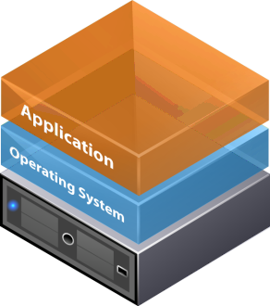
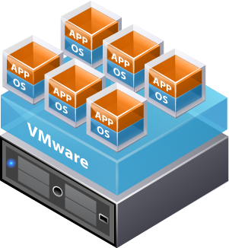

How does Server Virtualization Solve My Problems?
Physical World
Virtual World
1 :1
Many :1
1:1 relationship between applications and hardware
Many:1 relationship between applications and hardware
Traditional x86 Architecture
Legacy rule: Run only one application per server because single application crashes resulting in OS or server failure
Typical hardware utilization below 8%
Virtualization:
New rule: Run multiple applications per server because OS/applications are isolated from one another
Typical hardware utilization 80%
NNS

Slide 11
Key benefits of Server Virtualization
1
Make Better use of existing or new infrastructure
2
Save time in managing infrastructure
3
Improve application availability
4
Considerable amount of Savings
NNS

Slide 12
1
Make Better Use of Existing Infrastructure
Before VMware virtualization
After VMware virtualization
VMware
VMware
VMware
Servers | 10
Utilization | 8%
Servers | 3
Utilization | 80%
NNS

Slide 13
2
Save time in managing infrastructure
% of Time Spent on Maintenance
Major productivity improvements -
Zero downtime maintenance
Built-in high availability for all applications
Instant provisioning
Efficient patching
Monitoring from a single interface
On demand resource allocation to VM
Horizontal scaling of virtual infrastructure
72%
24%
Before VMware
After VMware
Did you ever get these benefits from your traditional HDDC ?
NNS

Slide 14
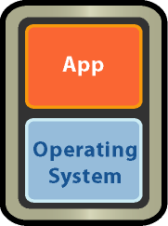

3
High Availability keeps business running
vSphere High Availability (HA)
Detect server failures and provide rapid recovery by automatically restarting VMs on available severs
Protect applications from operating system failures by automatically restarting VMs when an operating system failure is detected.
X
vSphere Cluster
NNS

Slide 15
4
Considerable amount of Savings
Real World customer example
Customer ‘A’ saved BDT 1 crore
By implementing VMware
Virtual infrastructure in 3 years
NNS

Slide 16
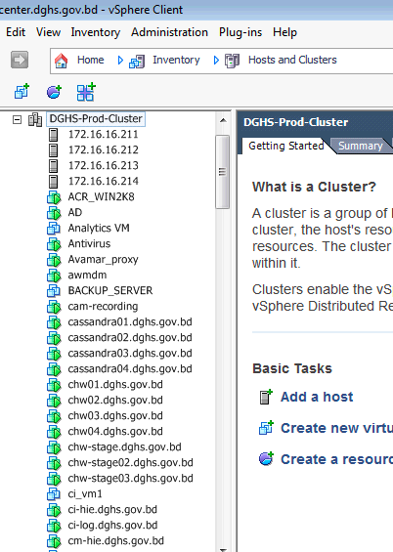
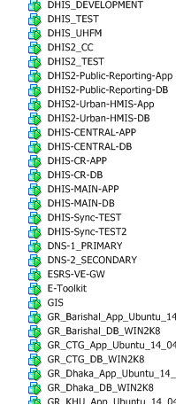
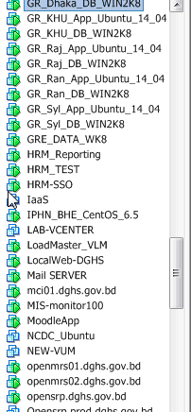
How many VM’s can be hosted in a vSphere Cluster?
The Ans is: It depends on the workloads of the VM’s
NNS

Slide 17
Virtual Infrastructure Resource Management and Monitoring
vRealize Operations Management
NNS

Slide 18
Why is Standalone vSphere Not Enough?
You need to know the health of your virtual infrastructure at a glance.
Your CIO needs health report about you VMware infrastructure.
You need to know if any virtual machine has under utilized resources so that you can reclaim resources from that and vice-versa.
NNS

Slide 19
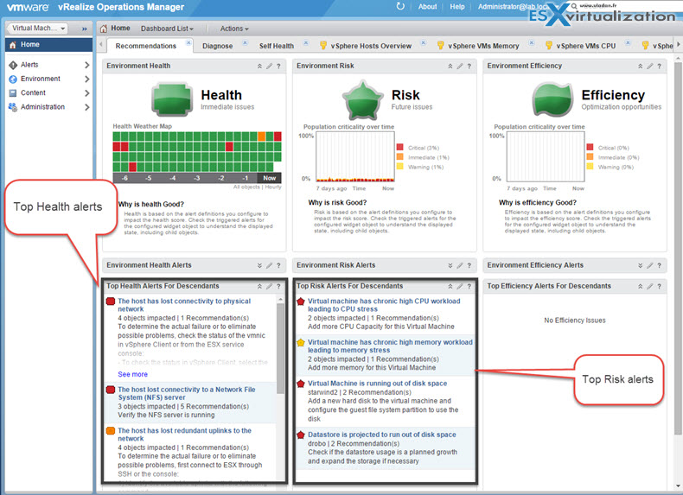
Intelligent/Operational Dashboard Shows Value – CIO’s view
Immediate Problems
Future Problems
Opportunities to Optimize
NNS

Slide 20
Storage Virtualization
VMware vSAN (2nd Pillar of SDDC)
NNS

Slide 21
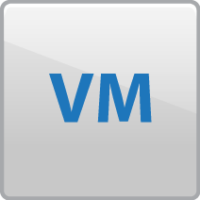


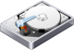
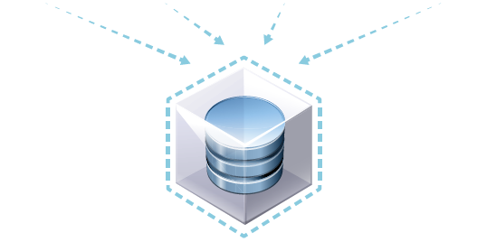
VMware Software Defined Storage vSAN
Overview
The next component of your SDDC is VMware vSAN
Software-defined storage optimized for VMs
Hypervisor-converged architecture
Runs on any standard x86 server
Pools HDD/SSD into a shared datastore
Delivers enterprise-level scalability and performance
Managed through per-VM storage policies
Deeply integrated with the VMware stack
Kernel embedded
Server-side read/write caching
Built-in failure tolerance
vSphere + Virtual SAN
…
SSD
Hard disks
SSD
Hard disks
SSD
Hard disks
NNS
Virtual SAN Datastore

Slide 22

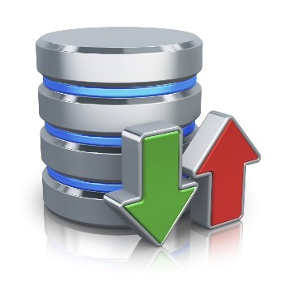
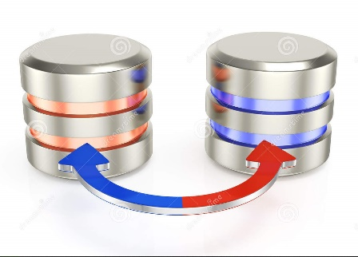
Expectation from a Storage System
Performance – Means Higher IOPS
Capacity / Scalability with cost benefit
High Availability
Notes:
The Software Defined Data Center
In SDDC, all three core infrastructure components, compute, storage and networking are virtualized.
Virtualization software abstracts underlying hardware, while pooling compute, network and storage resources to deliver better utilization, faster provisioning and simpler operations.
The VM becomes the centerpiece of the operational model, providing automation and agility to repurpose infrastructure according to business needs.
Today we will focus on Storage, which has been growing at an extremely rapid pace and is a fast changing aspect of the datacenter!

Slide 23
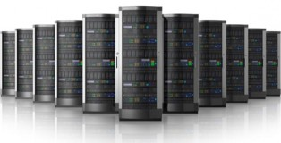
Performance (IOPS) benefit from vSAN
Traditional Storage Solution
VMware Virtual SAN
Maximum Scalability per Virtual SAN Cluster
Specialized Expensive HW
64
Hosts
6,400
VMs
6M+
IOPS
8.8
Petabytes
Costs get too higher for getting high IOPS Storage
If not, then most enterprises will loose productivity due to poor application performance
NNS
Notes: based on IOMeter 100% Read benchmark
Notes:
Beyond the big numbers on this page….
…Virtual SAN scales to the needs of your environment
Powerful storage tier running on heterogeneous server hardware
Most importantly…scales to the needs of customers.
32 node VSAN cluster
4.4 TBs of capacity
2M IOPs
3,200 VMs
Enterprise-grade persistent storage
Ideal and viable storage tier for vSphere environments
VSAN is high performance, scalable and resilient… and runs on heterogeneous hardware.
T: We have done quite a bit of testing to prove this out in our labs

Slide 24

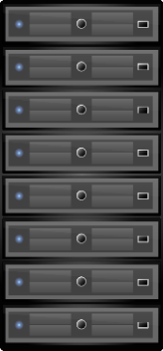
Traditional Storage Solution
vSAN Scalability
VMware Virtual SAN
Huge investment to deploy traditional storage system.
Once deployed you are vendor locked.
Small footsteps are one of the benefits of VMware Virtual SAN
Customer can start with just the minimal and add more just as needed .
NNS
Notes: based on IOMeter 100% Read benchmark
Notes:
Beyond the big numbers on this page….
…Virtual SAN scales to the needs of your environment
Powerful storage tier running on heterogeneous server hardware
Most importantly…scales to the needs of customers.
32 node VSAN cluster
4.4 TBs of capacity
2M IOPs
3,200 VMs
Enterprise-grade persistent storage
Ideal and viable storage tier for vSphere environments
VSAN is high performance, scalable and resilient… and runs on heterogeneous hardware.
T: We have done quite a bit of testing to prove this out in our labs

Slide 25

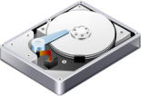

Scalable Architecture of Virtual SAN
Scale up and scale out architecture – Granular and linear storage with performance and compute scaling capabilities
For caching and capacity – Increase Disk group
For capacity- Increase magnetic disks
For both Compute & Capacity- Add entire node
Virtual SAN Datastore
disk group
disk group
disk group
disk group
disk group
scale up
scale out
Virtual SAN network
Virtual SAN network
Virtual SAN network
Virtual SAN network

Slide 26




Complexities regarding operational processes with traditional storage..
Multiple Storage Provisioning Steps
Realize need for more storage
Day 15
Submit
storage
request
Day 1
Virtual
Admin
Virtual
Admin
12
1
Receive
storage
request
Present storage to Virtual Admin
2
11
Storage
Admin
Storage
Admin
10
3
Assign
data
services
Get approvals
9
Format
LUNs /
volumes
4
8
Keep request in queue
Does Zoning & mapping
7
5
6
Build disk
pools
Identifiy LUNs /volumes
Assign RAID
levels
NNS

Slide 27
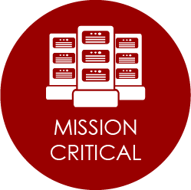



Performance, Scale and Availability for Any Application More than 7,000 customers have chosen to entrust their most important workloads to vSAN!
BUSINESS-CRITICAL APPLICATIONS
SAP
Horizon
Oracle
SAP Core Ready
Testing and validated deployments
Tightly integrated cloud management
Bundles Virtual SAN licenses for lowest
cost VDI storage
Oracle RAC supported
Testing and validated deployments
Notes:
Work is being done on SAP HANA. This may not make launch, but PE is working with SAP on this.
SAP Core apps are ready to be supported.
“Horizon should be deployed with VSAN”
Exchange DAG, Microsoft Always On as it was already is supported.
PE team has put together some impressive transaction numbers for Oracle.

Slide 28
Network Virtualization
VMware NSX (3rd Pillar of SDDC)
NNS

Slide 29
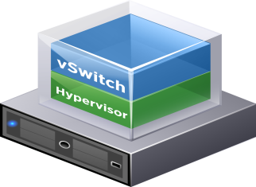

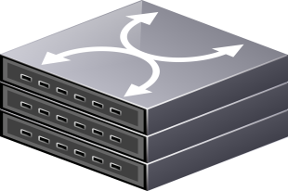

VMware NSX
Internet
Existing Physical Network
Server Hypervisors i.e. vSphere
NNS

Slide 30

NSX components are installed on top of vSphere as hypervisor kernel modules
VMware NSX
Internet
NSX
Existing Physical Network
NNS

Slide 31




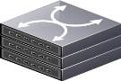
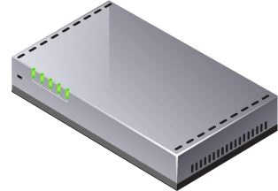
A Complete Virtual Network in Software – Logical Switching
1.1.2.0/24
Logical Switch (L2)
Virtual Network
In Software
Egress
1.1.1.0/24
L2
Logical Switch (L2)
Ingress
Network Hypervisor
IDS
Load Balancer
General Purpose IP Hardware
Physical Network
NNS

Slide 32
A Complete Virtual Network in Software – Distributed Routing
1.1.2.0/24
Egress
L2
Logical Switch (L2)
L3
Virtual Network
In Software
L3
1.1.1.0/24
L2
Logical Switch (L2)
Ingress
Network Hypervisor
IDS
Load Balancer
General Purpose IP Hardware
Physical Network
NNS

Slide 33
A Complete Virtual Network in Software – Distributed Firewalling
1.1.2.0/24
Egress
L2
FW
Logical Switch (L2)
L3
Virtual Network
In Software
L2
1.1.1.0/24
L3
FW
Logical Switch (L2)
Ingress
Network Hypervisor
IDS
Load Balancer
General Purpose IP Hardware
Physical Network
NNS

Slide 34
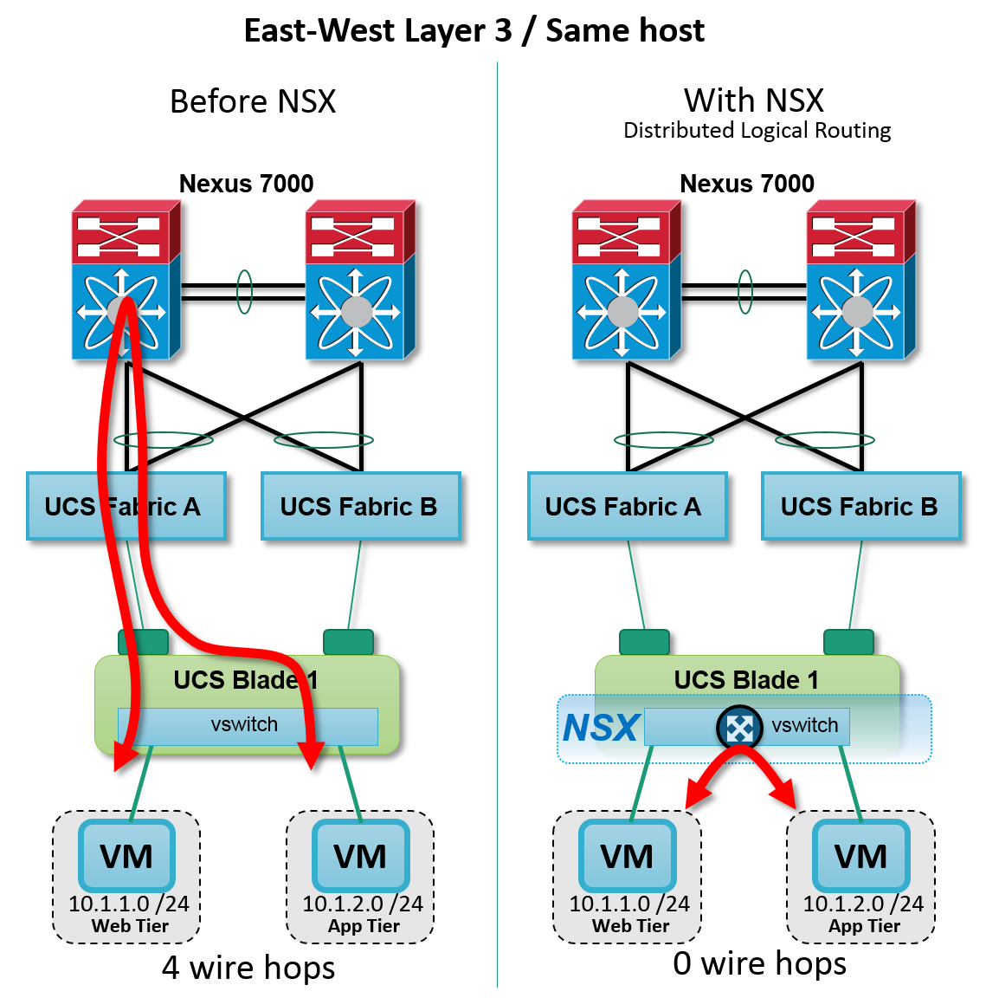
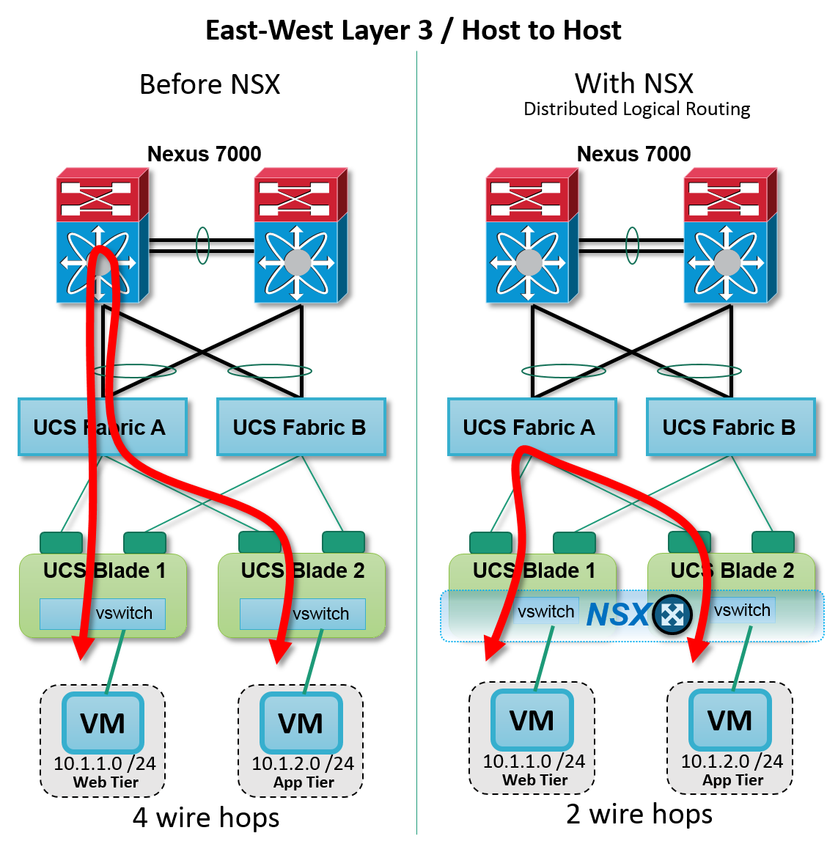
Routing without/with VMware NSX
East-West Layer 3 / Same Host
East-West Layer 3 / Host to Host
Fewer hops, more efficient and precise VM networking
NNS

Slide 35






Why are breaches still happening?
Unconstrained communication
Little or no lateral controls inside perimeter
Low priority systems are targeted first.
Attackers can move freely around the data center.
Internet
10110100110
101001010000010
1001110010100
Attackers then gather and exfiltrate data over weeks or even months.
Data Center Perimeter
NNS

Slide 36
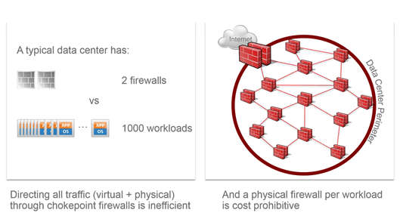

Security is needed everywhere, but we can’t have it everywhere
With traditional technology, this is operationally infeasible.
?
Why can’t we have individual firewalls for every VM?
Internet
?
Data Center Perimeter
NNS

Slide 37
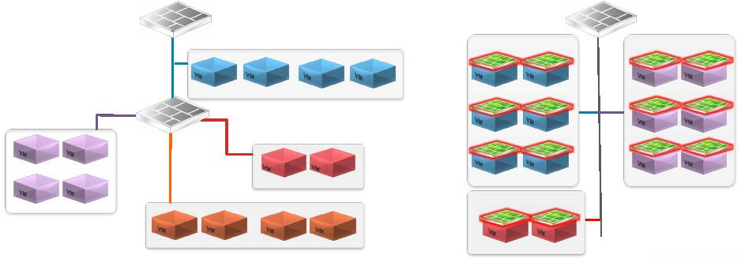
Achieving Micro-segmentation with VMware NSX
Traditional Data Center
NSX Data Center
Perimeter
Perimeter
firewall
firewall
DMZ/Web VLAN
HR Group
Finance Group
Inside firewall
Finance
HR
DMZ/Web
DMZ/Web
App VLAN
Services/Management VLAN
App
App
HR
DB
Services
Mgmt
DB
Finance
DB VLAN
Services/Management
Group
Finance
HR
Services
Mgmt
Location (Physical, Logical) of VMs is constrained by the networks and systems they need to access
Communication within a VLAN is uncontrolled
Each VM can now be its own perimeter
Policies align with security groups
Control communication within a single VLAN
Streamlines new VM deployment - security policies automatically inherited
NSX segmentation simplifies network security
18
NNS

Slide 38
Business Continuity
VMware SRM (4th Pillar of SDDC)
NNS

Slide 39
Best Practices for Recovery Risk Mitigation
Frequent testing to ensure DR plan correct & successful
Orchestration to minimize mistakes and speed up recovery time
Tight integration between infrastructure management and DR solution
Multiple layers of downtime protection at all levels of the datacenter
NNS

Slide 40

Reducing and Managing Recovery Risk
Recovery Risk
IT Environment without Virtualization & DR orchetration
Changes to Applications & Infrastructure Configuration
TESTING GAP
DR Test
DR Test
Time
Unproven Recoverability
Recovery Risk
Virtualization + DR orchestration (SRM)
During the testing gap, organizations can’t be sure that they can recover the current IT environment
A failover scenario may take days or weeks to complete, leaving the business at extreme risk
Frequent DR Testing
DR Test
DR Test
Time
Virtualization & DR orchestration Greatly Reduce Recovery Risk
NNS

Slide 41






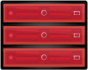
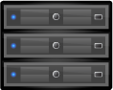
vCenter Site Recovery Manager Ensures Simple, Reliable DR
Site Recovery Manager Complements vSphere to provide the simplest and most reliable disaster protection and site migration for all applications
Provide cost-efficient replication of applications to failover site
Built-in vSphere Replication
Broad support for storage-based replication
Simplify management of recovery and migration plans
Replace manual runbooks with centralized recovery plans
From weeks to minutes to set up new plan
Failover and migration processes for reliable recovery
Enable frequent non-disruptive testing
Ensure fast, orchestrated failover
Orchestrated failback processes
Site A (Primary)
Site B (Recovery)
VMware
vCenter Server
Site Recovery
Manager
VMware
vCenter Server
Site Recovery
Manager
VMware vSphere
VMware vSphere
Servers
Servers
NNS

Slide 42





SRM Provides Broad Choice of Replication Options
Site A (Primary)
Site B (Recovery)
vCenter Server
Site Recovery Manager
vCenter Server
Site Recovery Manager
vSphere
vSphere
vSphere Replication
Storage-based replication
NNS

Slide 43
How do we Overcome DR challenges?
NNS

Slide 44
How do we handle Site failure?
Need to maintain same set of Servers and other hardware at both sites
Increases RTO
Complexity in maintaining identical configurations at both sites
DR Drill requires huge planning, documentation and time
We never perform efficient disaster recovery with our traditional hardware defined data center.
NNS

Slide 45

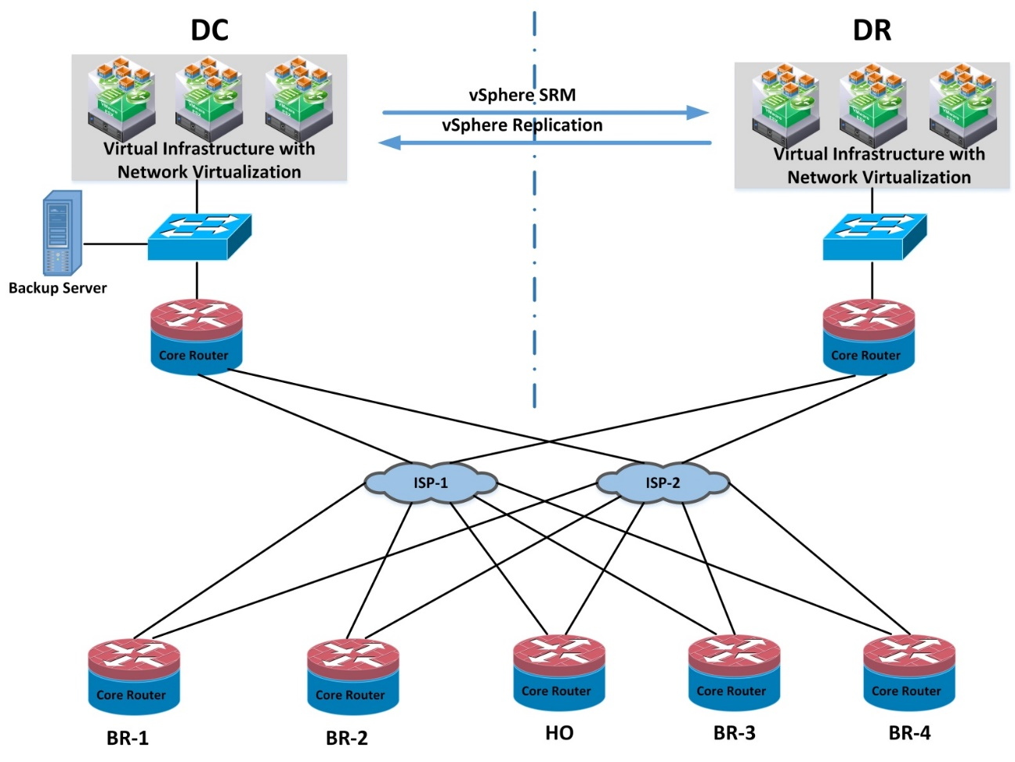
Server Virtualization, Storage Virtualization and Business Continuity with software defined networking (NSX) approach
HDDC
SDDC
NNS

Slide 46
Our Recent SDDC case study
NNS

Slide 47



SP
Site-1
Primary Site
Physical Router
Site-2
Recovery Site
Physical Router
RTO 30 Minutes
Physical FW
Physical FW
ESG
ESG
Universal Distributed Logical Router (UDLR)
NSX Load Balancer
NSX Load Balancer
vSphere vMotion
WEB L2
APP L2
VMware SRM
DB L2
Host-1
Host-2
Host-5
Host-1
Host-2
Host-3
Universal Distributed Firewall (UDFW)
NNS
vSphere+VSAN Cluster
vSphere Replication
vSphere+VSAN Cluster

Slide 48
Thank you
NNS

